Slide 1
Service computing
Main concepts and importance

Slide 2
Service computing main concepts
Service
Service computing
Service oriented architecture

Slide 3
Service

Slide 4





Service

Slide 5
Service
Services represent a type of relationships-based interactions (activities) between at least one service provider and one service consumer to achieve a certain business goal or solution objective.

Slide 6
What is Service Computing?
Services Computing is a cross-discipline that covers the science and technology of bridging the gap between business services and IT services.
Supports integrating the business as linked, repeatable business tasks, or services.

Slide 7
Consider this example
You are a software developer for a large manufacturing company that has their factories, warehouses and clients located in diverse locations across China
You work in the IT department of this company and your job is to develop apps for other departments based on their business needs
Let’s see some examples of the tasks you may need to accomplish

Slide 8
Task 1 – develop an app for the drivers
Drivers need to deliver the products from the warehouses to the customers
The app needs to have some of the functions below
Display the addresses of the customers and their purchase orders
Display the addresses and inventory level of the warehouses
Display the daily tasks - the list of the customers to be visited on a given day
Give the driver the best routes for delivery

Slide 9
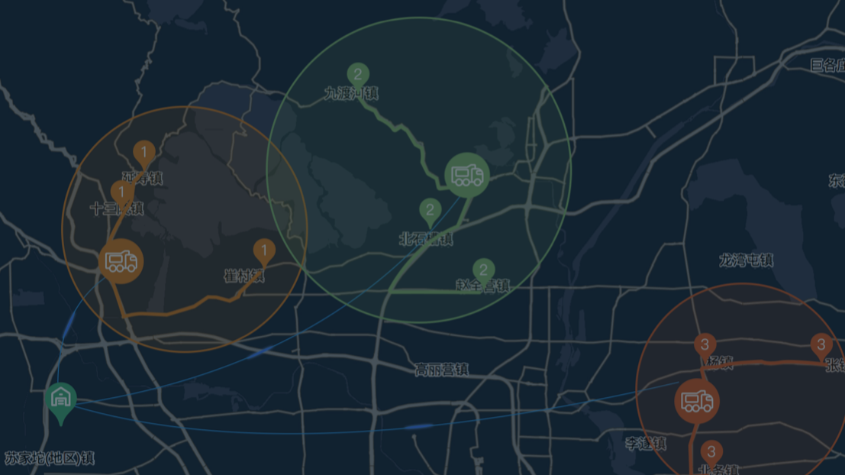
Task 1 – develop an app for the drivers
What modules do you need to develop for this app?
Customer database
Purchase order database
Warehouse database
UI to display daily task
Map interface to display the delivery route
…
…
Sales App
Map functions
Module 1
Module 2
Module 3
Module 4
Module 5
Module 6
Module 7
…

Slide 10
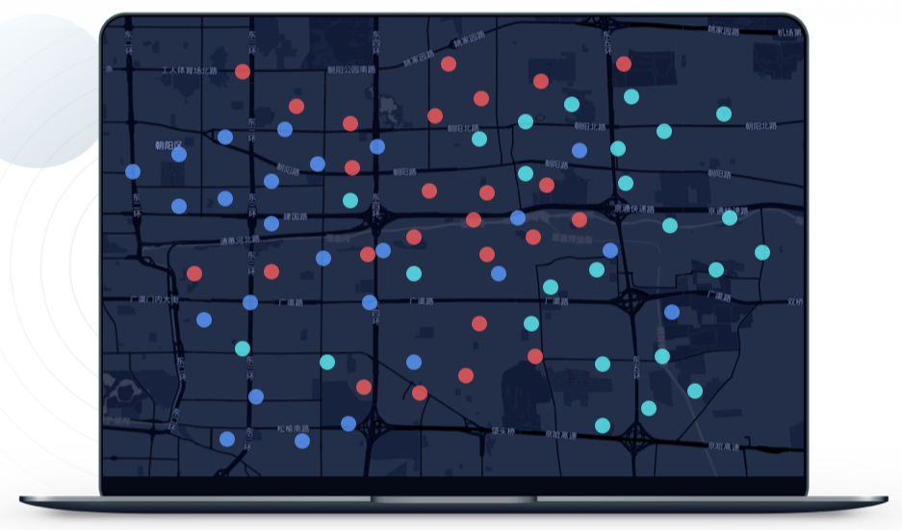
Task 2 – develop an app for the warehouse employees
The warehouses employees need an inventory control system – some of the functions they would like to have
Visualize amount of product available in each warehouse
Visualise production capacity of each factory
Driver App
Map functions
Module 1
Module 2
Module 3
Module 4
Module 5
Module 6
Module 7
…

Slide 11
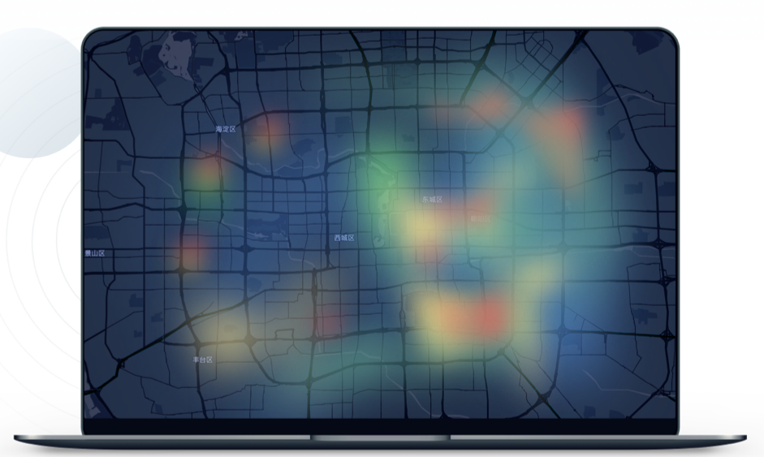
Task 3 – develop an app for the sales team
The sales team needs to track the sales, they would like to be able to generate diverse reports such as
Which customers bought the most/least products in a given period of time
Which product’s sales were the highest/lowest in a given period of time
Which city in China were the largest/smallest market for this product
Sales App
Map functions
Module 1
Module 2
Module 3
Module 4
Module 5
Module 6
Module 7
…

Slide 12
Driver App
Map functions
Module 1
Module 2
Module 3
Module 4
Module 5
Module 6
Module 7
…
Warehouse App
Map functions
Module 1
Module 2
Module 3
Module 4
Module 5
Module 6
Module 7
…
How to make your development work more efficient?
Sales App
Map functions
Module 1
Module 2
Module 3
Module 4
Module 5
Module 6
Module 7
…

Slide 13
How to make your development work more efficient?
You noticed that in all of the tasks you were working on previous year, there was a need to develop some kind of map functions

Slide 14
Abstracting commonly used functions
Can you abstract these map functions and reuse them in all of the apps that need it?
Develop map component as a standalone function and add an interface (API) that can interact with your other APPs.
One of the ways to achieve that is to build your own Web Service

Slide 15
Driver App
Map functions
Module 1
Module 2
Module 3
Module 4
Module 5
Module 6
Module 7
…
Warehouse App
Map Web Service
Map functions
Module 1
Module 2
API
Map functions
Module 3
Module 4
Module 5
Module 6
Module 7
…
Sales App
Map functions
Module 1
Module 2
Module 3
Module 4
Module 5
Module 6
Module 7
…

Slide 16
Driver App
Service consumer
Module 1
Map functions
Module 2
Module 3
Module 4
Module 5
Module 6
Module 7
…
Warehouse App
Map Service Provider
Service consumer
Module 1
Map functions
Module 2
Interface
Map functions
Module 3
Module 4
Module 5
Module 6
Module 7
…
Sales App
Communication language
Service consumer
Module 1
Map functions
Module 2
Module 3
Module 4
Module 5
Module 6
Module 7
…

Slide 17
Towards service orientation
In our example, we have changed the design of our software
We identified one of the software components “Map functions”
We made this software component reusable using service interfaces that use a common communication language over a network

Slide 18
Service (definition 1)
Services represent a type of relationships-based interactions (activities) between at least one service provider and one service consumer to achieve a certain business goal or solution objective.

Slide 19
Driver App
Service consumer
Module 1
Map functions
Module 2
Module 3
Module 4
Module 5
Module 6
Module 7
…
Warehouse App
Map Service Provider
Service consumer
Module 1
Map functions
Module 2
Interface
Map functions
Module 3
Module 4
Module 5
Module 6
Module 7
…
Sales App
Communication language
Service consumer
Module 1
Map functions
Module 2
Module 3
Module 4
Module 5
Module 6
Module 7
…

Slide 20
Service Provider
Service consumer
Communication language
Interface
Functions

Slide 21
Service (definition 1)
Services represent a type of relationships-based interactions (activities) between at least one service provider and one service consumer to achieve a certain business goal or solution objective.
Service Provider
Service consumer
Communication language
Interface
Functions

Slide 22
Service (definition 2)
A service is a self-contained unit of software functionality, or set of functionalities, designed to complete a specific task such as retrieving specified information or executing an operation.
Service Provider
Service consumer
Communication language
Interface
Functions

Slide 23
Service (definition 2-cont.)
It contains the code and data integrations necessary to carry out a complete, discrete business function and can be accessed remotely and interacted with or updated independently
Service Provider
Service consumer
Communication language
Interface
Functions

Slide 24
Service oriented architecture
Service-oriented architecture (SOA) is a type of software design that makes software components reusable using service interfaces that use a common communication language over a network.

Slide 25
Service oriented architecture
SOA integrates software components that have been separately deployed and maintained and allows them to communicate and work together to form software applications across different systems.

Slide 26
Driver App
Service consumer
Module 1
Map functions
Module 2
Module 3
Module 4
Module 5
Module 6
Module 7
…
Warehouse App
Map Service Provider
Service consumer
Module 1
Map functions
Module 2
Interface
Map functions
Module 3
Module 4
Module 5
Module 6
Module 7
…
Sales App
Communication language
Service consumer
Module 1
Map functions
Module 2
Module 3
Module 4
Module 5
Module 6
Module 7
…

Slide 27
Let’s come back to our example - App 1
The drivers mentioned that they would also like to see the traffic information and choose the best route based on that
Do you have access to traffic reports that you can use in your app?
Is there any existing map that you can use instead of building your own Map Web Service?

Slide 28
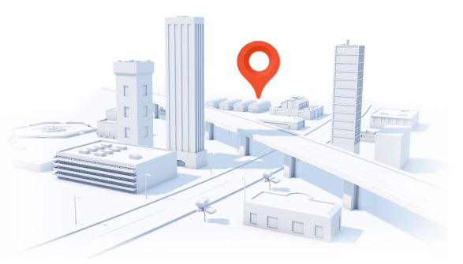
Let’s come back to our example - App 1
The drivers mentioned that they would also like to see the traffic information and choose the best route based on that
Do you have access to traffic reports that you can use in your app?
Is there any existing map that you can use instead of building your own Map Web Service?
You can use the Baidu Map services – initiate request to their Web Service using provided API
https://lbsyun.baidu.com/

Slide 29
Baidu Map as a service - cases
https://api.map.baidu.com/lbsapi/cloud/case.htm
Have a look at some real examples if you are interested

Slide 30
Service oriented architecture
Service-oriented architecture (SOA) is a type of software design that makes software components reusable using service interfaces that use a common communication language over a network.
SOA integrates software components that have been separately deployed and maintained and allows them to communicate and work together to form software applications across different systems.

Slide 31
How you can build applications with service orientation
You can develop your own services and use them as part of your applications
You do not need develop your own services – you can use existing services, developed and maintained by other organizations
…
You can make a service a part of your application
You can build your application by composing several existing services
…

Slide 32
What is Service Computing?
Services Computing is a cross-discipline that covers the science and technology of bridging the gap between business services and IT services.
Supports integrating the business as linked, repeatable business tasks, or services.

Slide 33
Service computing importance
Why it all started – a bit of history, background of service orientation
Importance to the community now – current benefits of service orientation
Importance to you – why should you learn about it

Slide 34
A bit of history
Background of service orientation

Slide 35
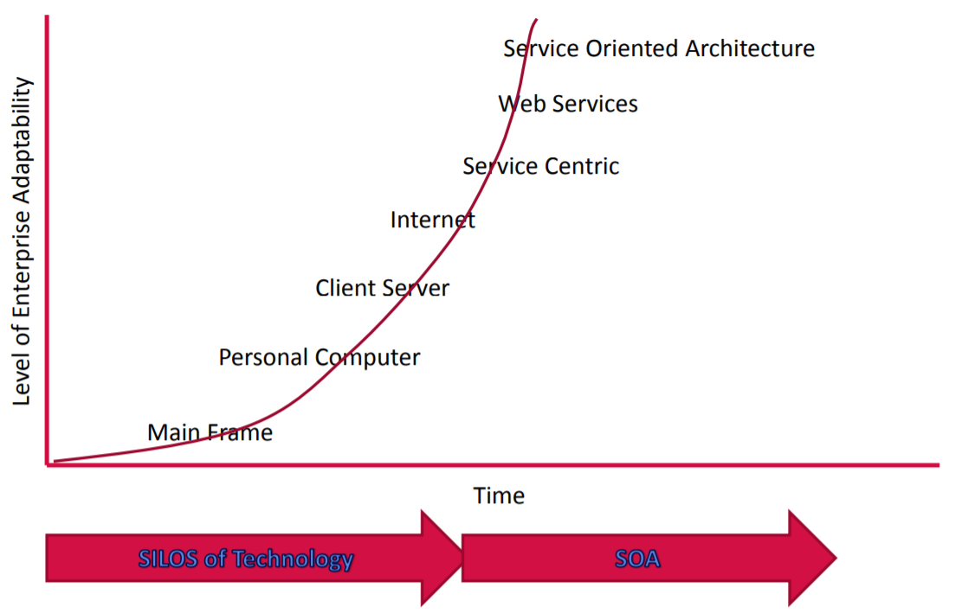
Towards Service Computing in an Enterprise

Slide 36
Towards Service Computing in an Enterprise

Slide 37
How programs were written in 60s?

Slide 38
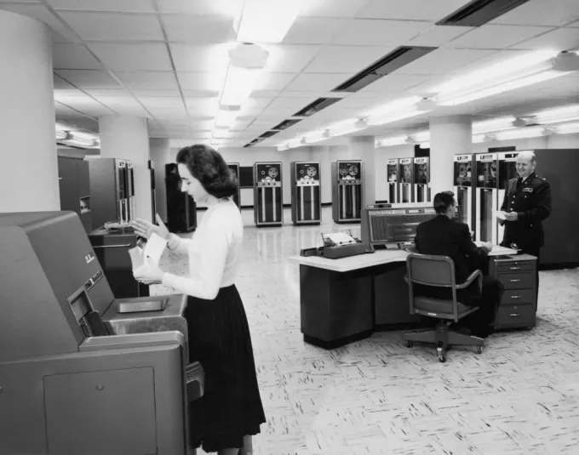
Main Frame
A typical corporate or computer installation had
a suite of rooms, with a large, access-restricted, air-conditioned room for the computer
a smaller quieter room for submitting jobs

Slide 39
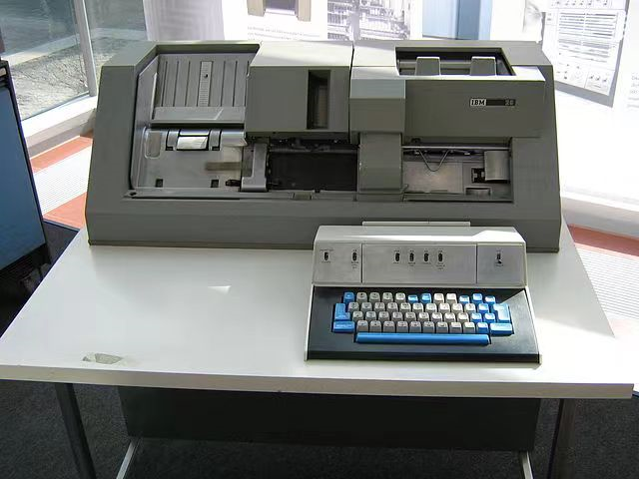
Main Frame
Nearby was a room full of keypunch machines for programmer use

Slide 40
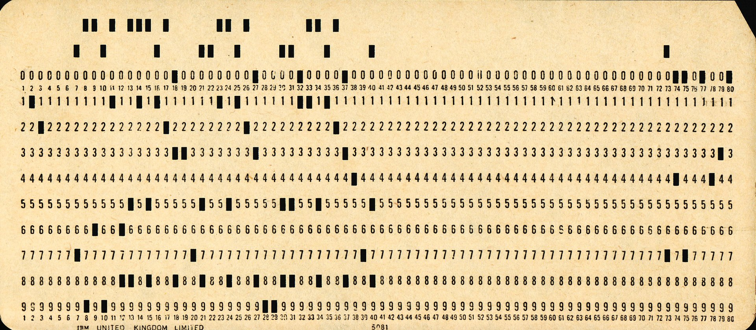
Main Frame
At that time, most computer programmers created, edited and stored their programs line by line on punch cards
a flexible write-once medium that encodes data

Slide 41
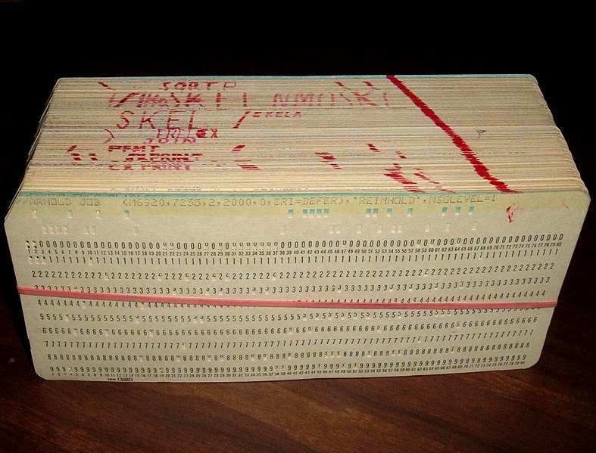
Main Frame
Groups or "decks" of cards form programs and collections of data

Slide 42
Main Frame
Programmers submitted the program decks, to be read by the program, to a person working behind a counter in the computer room

Slide 43
Main Frame
It could take hours or days between submitting a job to the computing center and receiving the output

Slide 44
Main Frame - disadvantages
Computer
Large
Too expensive too be owned by a single person
Operated by a highly skilled personnel

Slide 45
Towards Service Computing in an Enterprise

Slide 46
Personal Computer
Relatively small
Can be afforded by individuals
No high level skills needed to operate it

Slide 47
We will continue this topic on Friday

